Slide 1



VIKRAMSHILA - 3
Presents
A structured presentation designed by 9 key team members on
Climate Change
9 Participants
|
Summary of information
|
Detailed explanation

Slide 2


















Participant Roster (9 Members)
Hempushpa.S
Lead Presenter
Janvhi.I
Co-Presenter
Atharva.S
Technical Lead
NAME:
NAME:
NAME:
ROLE:
ROLE:
ROLE:
SIGN:
SIGN:
SIGN:
NAME:
Shrawan.D
Q&A Coordinator
NAME:
Manas.J
Scriptwriter
NAME:
Shlok.R
Data Analyst
ROLE:
ROLE:
ROLE:
SIGN:
SIGN:
SIGN:
NAME:
Vedanshu.A
Timekeeper
NAME:
Armaan.T
Rehearsal Coach
NAME:
Praanmay.B
Subject Matter Expert
ROLE:
ROLE:
ROLE:
SIGN:
SIGN:
SIGN:

Slide 3

Climate Change & Loss & Damage
An in-depth analysis of planetary thresholds, international law, climate justice equity, financial mechanisms, and security impacts on the Indian Armed Forces.

Slide 4

What is Climate Change ?
Planetary Mechanics
Systemic Escalation & Risks
Climate change refers to long-term shifts in global temperatures and weather patterns. Anthropogenic emissions of greenhouse gases (CO₂, CH₄, N₂O) trap thermal radiation in Earth's atmosphere, escalating global average temperatures by 1.1°C above pre-industrial levels.
Warming disrupts ocean currents, alters jet streams, accelerates polar ice melt, and triggers cascading planetary tipping points. These shifts compound extreme weather frequency, ocean acidification, and irreversible ecosystem collapses worldwide.

Slide 5

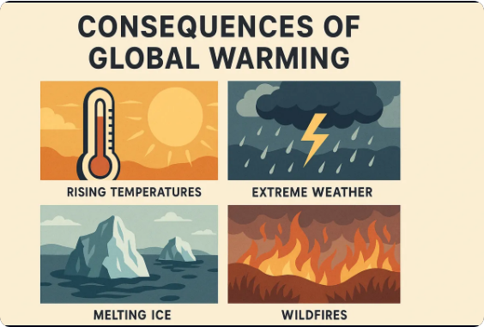
Human, Social & Rights Dimensions
Social Disruption: Displacement of communities creating millions of climate refugees and destabilizing regional socio-economic structures.
Health & Mortality: Surging vector-borne diseases, severe heat stress morbidity, and acute malnutrition from agricultural shocks.
Human Rights Vulnerability: Encroachment on fundamental rights to water, shelter, self-determination, and bodily security for frontline populations.

Slide 6




Ecological and Territorial Losses
Marine Systems
Terrestrial Biomes
Sovereignty Loss
Severe ocean acidification and warming cause catastrophic coral bleaching, collapse of marine food webs, and irreparable destruction of coastal fisheries.
Rapid desertification, rampant forest diebacks, and mass species extinction alter terrestrial ecosystems permanently past recovery thresholds.
Sea-level rise causes total inundation of Small Island Developing States (SIDS), resulting in irreversible loss of ancestral lands and sovereign maritime territory.

Slide 7


Three Pillars of Climate Policy
Pillar Structure under UNFCCC
1. Mitigation:
Meaning: Actions taken to reduce or prevent greenhouse gas emissions.
Goal: Limit global temperature rise to well below 2°C, aiming for 1.5°C above pre-industrial levels.
Key Tools: Nationally Determined Contributions (NDCs), renewable energy scaling, carbon pricing, and fossil fuel phase-outs.
2. Adaptation:
Meaning: Processes and plans to adjust to actual or expected climate change and its effects.
Goal: Protect human lives, infrastructure, ecosystems, and livelihoods from worsening climate impacts like floods, heat waves, and sea-level rise.
Key Tools: National Adaptation Plans (NAPs) and building climate-resilient agriculture and water systems
3. Finance:
Meaning: Local, national, or transnational financing—drawn from public, private, and alternative sources of capital—that seeks to support mitigation and adaptation actions that address climate change.
Goal: Mobilize and scale up investments to support developing nations, transition to a low-emission economy, and build climate resilience globally.
Key Tools: Green banks, climate funds (e.g., Green Climate Fund), green bonds, carbon markets, and private-public partnerships (PPPs).
CORE PILLARS

Slide 8

Evolution of Loss & Damage Law
COP27 establishes & COP28 operationalizes the global Loss & Damage Fund.
COP27 (2022) established a historic Loss and Damage fund to financially support vulnerable nations facing severe climate impacts. COP28 (2023) operationalized this fund and marked the first Global Stocktake, explicitly calling on countries to transition away from fossil fuels and triple global renewable energy capacity by 2030.
2013 - WIM Created
COP19 (2013) established the Warsaw International Mechanism for Loss and Damage associated with Climate Change Impacts to address loss and damage associated with the impacts of climate change, including extreme events and slow onset events, in developing countries particularly vulnerable to the adverse effects of climate change.
1991 - AOSIS Proposal
he 1991 Alliance of Small Island States proposal was a landmark submission that first introduced the concept of international climate-related loss and damage compensation and an international insurance pool for sea-level rise.
Vanuatu advanced the proposal on behalf of AOSIS in June 1991 during the second session of the Intergovernmental Negotiating Committee for what would become the UN Framework Convention on Climate Change
2015 - Paris Art. 8
Parties agree to minimize climate-related loss and damage from extreme weather and slow-onset events through sustainable development. Governed by the Parties, the Warsaw International Mechanism will be enhanced to drive cooperative understanding, action, and support for addressing these impacts

Slide 9

Events, Equity & Climate Justice
Rapid v/s Slow-Onset Events
Historical Carbon Equity
RAPID-ONSET : Rapid onset events are sudden, extreme climate hazards—like flash floods, hurricanes, and severe storms—that unfold in hours or days, causing immediate, widespread destruction to lives, property, and local infrastructure.
SLOW-ONSET : Slow onset events are climate hazards that develop gradually over years or decades—such as sea-level rise, desertification, ocean acidification, and glacial retreat—causing severe long-term environmental and economic impacts.
Developing nations contribute minimally to historical global cumulative emissions, yet bear the severe brunt of climate losses.
Climate justice mandates financial compensation and technology transfers grounded in Common But Differentiated Responsibilities (CBDR).

Slide 10
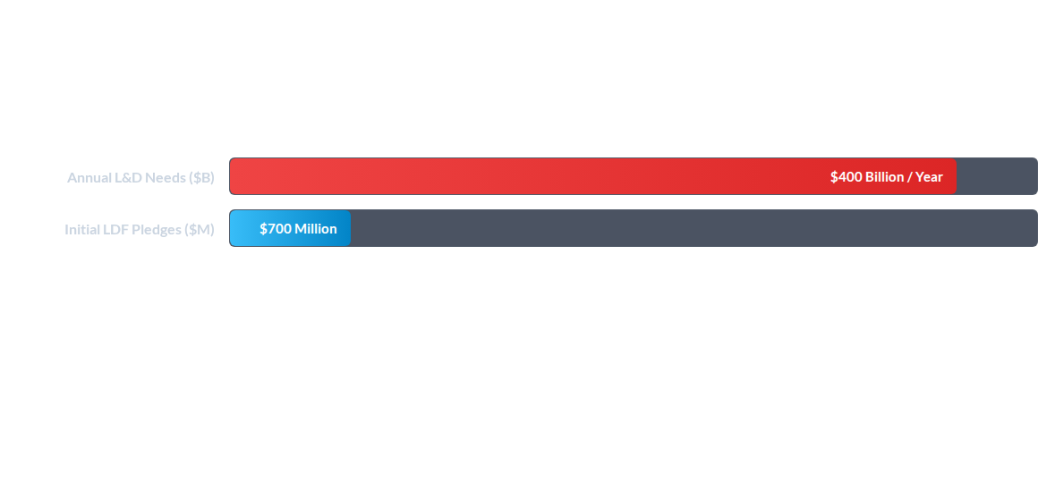
Finance & Governance Realities
Governance challenges involve interim World Bank hosting, non-debt grant disbursement mechanisms, and quantifying non-economic losses like cultural heritage and indigenous knowledge.

Slide 11
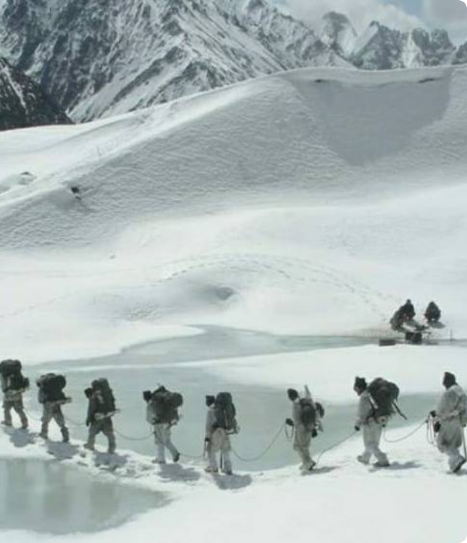
Impact on Indian Army Operations
1) Himalayan Glacier Retreat: Glacial melting in Siachen and Ladakh creates unpredictable avalanche hazards, flash floods, and water scarcity at high-altitude posts.
2) Border Security Shift: Diminishing winter snow along the LoC and LAC alters natural defensive barriers, extending infiltration windows year-round.
3) Border Infrastructure: BRO face severe project delays due to extreme precipitation damaging bitumen, roads, and bridges.

Slide 12
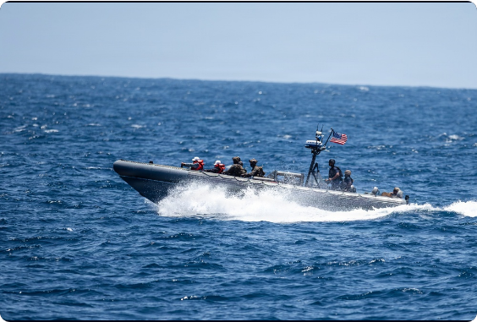
Impact on Navy & Air Force Ops
Indian Navy Coastal Risks: Sea-level rise and severe cyclones threaten low-lying naval infrastructure, notably in Andaman & Nicobar (< 5m elevation).
Air Force Operations: High density altitudes caused by extreme heat cut aircraft payload capacities; weather volatility disrupts tactical flight sorties.
HADR Strain: Escalating natural disasters require frequent deployment of Navy & IAF assets for Humanitarian Assistance and Disaster Relief across the IOR.

Slide 13
Future Outlook & Global Challenges
Climate-Resilient Defense Planning: Integrating meteorological and hydrological intelligence into military acquisition, mission planning, and base hardening.
Scalable & Direct Climate Finance: Bridging the multi-billion dollar gap in Loss & Damage funding through innovative levies and non-debt mechanisms.
Legal & Institutional Frameworks: Establishing robust international legal definitions for non-economic loss, climate migration, and state responsibility under international law.

Slide 14

Questions & Discussion
Building Global Resilience & Ensuring National Security in a Changing Climate.
UNFCCC Policy & National Security Analysis

Slide 15



Image Sources
https://www.oneearthonechance.com/images/consequencesofglobalwarming.webp
Source: www.oneearthonechance.com
https://i.redd.it/mmxhy5twc2n51.jpg
Source: www.reddit.com
https://d1ldvf68ux039x.cloudfront.net/thumbs/photos/2609/9915589/1000w_q95.jpg
Source: www.dvidshub.net

